Slide 1
Neighborhood Homes Investment Act
Reinvest | Repopulate | revitalize

Slide 2
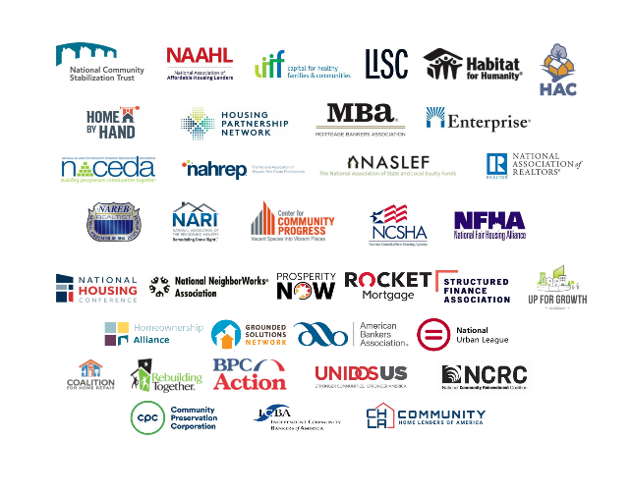
Neighborhood Homes Coalition

Slide 3
What Problem Are We Trying to Solve?
Every state has neighborhoods with homes in poor condition and property values too low to support new construction or substantial renovation. The lack of move-in ready homes makes it difficult to attract or retain homebuyers, causing property values to decline.
101 million of the 135 million housing units in the US are in buildings with four or fewer units.
40% of U.S. housing stock is at least 50 years old.
The lack of supply of move-in ready homes is a particular challenge for first time homebuyers who struggle to find suitable properties to purchase.

Slide 4
What Are We Proposing?
Neighborhood Homes Investment Act
S. 657 (118th Congress)
Introduced by Senators Ben Cardin (D-MD), Todd Young (R-IN), Ron Wyden (D-OR), Jerry Moran (R-KS), and Sherrod Brown (D-OH)
H.R. 3940 (118th Congress)
Introduced by Representatives Kelly (R-PA) and Higgins (D-NY), Claudia Tenney (R-NY), Dan Kildee (D-MI, Randy Feenstra (R-IA), and Dwight Evans (D-PA)

Slide 5
What Are We Proposing?
Neighborhood Homes Investment Act
A new federal tax credit to attract capital to build and rehabilitate 500,000 owner-occupied homes in distressed urban, suburban and rural neighborhoods over the next decade
No other federal tax incentive addresses a key problem: development costs exceed market values for owner-occupied homes in distressed neighborhoods. Neighborhood Homes complements but does not duplicate:
Tax-exempt mortgage bonds: reduce monthly payments, not development cost gaps
Low Income Housing Tax Credits: for rentals, not homeownership
Opportunity Zones and New Markets Tax Credits: not designed to fill the valuation gap on homeownership

Slide 6
Source of Neighborhood Homes Tax Credits
States allocated tax credits based on population;
$7 per capita, with a small state minimum of $9 million.
Nationwide total: >$2 billion a year, adjusted for inflation
State housing finance agencies likely to be the program administrators.

Slide 7
How Would Neighborhood Homes Work?
States write allocation plans with selection criteria
Criteria include: (1) neighborhood need; (2) impact on neighborhood stability/revitalization and residents; (3) project sponsor capability and track record; (4) likely long-term ownership results; (5) any other state criteria
States set standards for construction cost and quality and developer fees
States make allocations to Neighborhood Homes sponsors
Could include developers, investors, lenders
Neighborhood Homes sponsors use allocation to raise equity capital from investors and build/rehab homes
Investors can claim credits once the home is occupied by an eligible homeowner

Slide 8
Eligible Neighborhoods
Eligible census tracts must meet these three criteria:
Poverty rate at least 130% of area poverty rate
Median family income less than 80% of area median income
Median home value less than 100% of area median home value
Additional census tracts eligible in high poverty cities
States may develop additional criteria
Covers approximately 20% of all census tracts; 25% of non-metro tracts
Up to 20% of allocations may be provided to:
certain additional non-metro census tracts,
owner-occupied rehabs in certain gentrifying census tracts, and
communities impacted by natural disaster, as well as certain homes with crumbling foundations

Slide 9
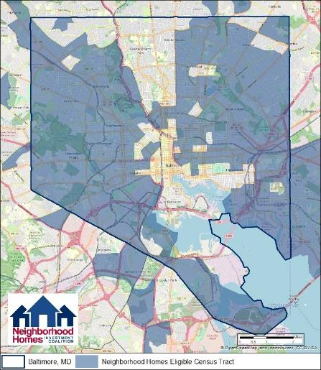
Eligible Neighborhoods: Baltimore

Slide 10
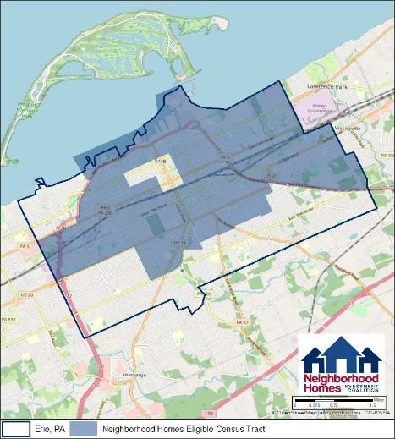
Eligible Neighborhoods: Erie, PA

Slide 11
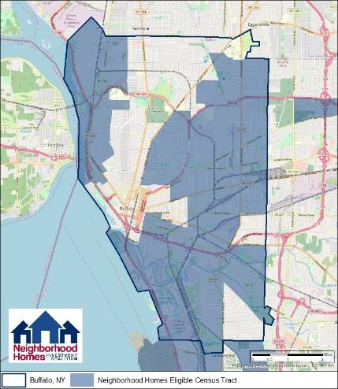
Eligible Neighborhoods: Buffalo

Slide 12
Eligible Neighborhoods: Indiana

Slide 13
Creating your own Neighborhood Homes Map
Go to neighborhoodhomesinvestmentact.org
On the home page, scroll and select “Explore Interactive Map”
You will be taken to the Neighborhood Homes map interface

Slide 14
Eligible Home Types
Home Types
Houses with 1-4 units
Condominium units
Cooperative housing
Development Types
New construction for sale
Substantial rehab for sale
Owner-occupied rehabs

Slide 15
Eligible Homeowners and Home Prices
Homeowners with incomes up to 140 percent of the area median family income (MFI).
100% of MFI for owner-occupied rehabs
Maximum home price cannot exceed 4 times the area MFI
Example:
MFI = $90,000
Maximum homeowner income = $126,000
Maximum home price = $360,000
Source: 2018 HUDUser Database

Slide 16
Neighborhood Homes Tax Credit Amount
For new construction or substantial rehabilitation of homes that are sold, the tax credit covers the gap between development costs and net sales price. The credit is capped at 35% of the lesser of:
total development costs (acquisition, demolition, rehab, and construction); or
80% of national median sales price for new homes
For rehabilitation of owner-occupied homes, the tax credit amount is 50% of eligible costs, capped at $50,000
$20,000 minimum rehab per unit, adjusted for inflation

Slide 17
Claiming the Neighborhood Homes Tax Credit
Neighborhood Homes credits are claimed when a home is completed, inspected, and occupied by an eligible owner.
Unlike other credits, there is not a lengthy compliance period where investors may be subject to recapture.
If the home resells within five years of purchase, the homeowner must pay a declining percentage of the gain to the state for re-use on Neighborhood Homes eligible projects (50% in year 1…10% in year 5)

Slide 18
Protecting Against Gentrification
Eligible neighborhoods have median home values below the area median
Eligible homeowner income is limited to 140% of MFI
Home sales prices are limited to 4X MFI
Eligible basis for tax credits is limited to 80% of the national median new home price
States must consider impact on existing residents as a selection criteria

Slide 19
Financing Example: New Construction
Land Acquisition | $ 50,000
Construction Costs | 250,000
Total Development Cost | $300,000
Less: Sales Price | (240,000)
Gap | $ 60,000
Maximum NHIA Tax Credit (35% of $300,000) | $105,000
NHIA Tax Credit Allowed | $ 60,000

Slide 20
Financing Example: Rehabilitation
Land/building acquisition | $ 75,000
Rehabilitation | 125,000
Total Development Cost | $200,000
Less: Sales Price | ($160,000)
Gap | $ 40,000
Maximum Tax Credit (35% of $200,000) | $ 70,500
Tax Credit Allowed | $ 40,000

Slide 21
Financing Example: Homeowner Rehabilitation
Rehabilitation cost | $60,000
Tax credit used as borrower discount (50% of $60,000) | $30,000
Other sources (e.g., loan proceeds, homeowner equity, grants) | $30,000

Slide 22
Neighborhood Homes Projected Outcomes
Outcomes over 10 years
500,000 homes built or rehabilitated
$125 billion of total development activity
861,000 jobs in the construction and related industries
$56 billion in wages and salaries
$26 billion in federal tax revenues and fees
$12 billion in state and local tax revenues and fees
Reduction of blight and vacant properties
Homeownership opportunities and asset-building for wide range of households

Slide 23
Contact Us
For more information about the Neighborhood Homes proposal and coalition advocacy efforts, please visit our website:
www.neighborhoodhomesinvestmentact.org

